Slide 1
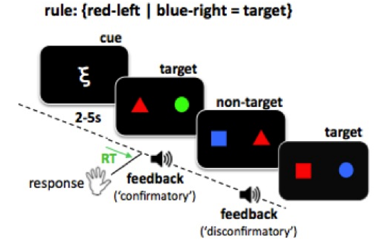
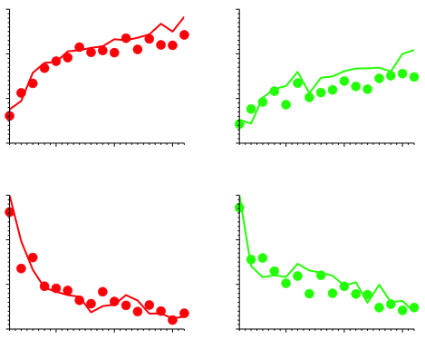
A
B
Familiar
Novel
1.0
0.5
% accuracy
0.0
1
5
10
15
1
5
10
15
1.0
% choose target
0.5
0.0
1
5
10
15
1
5
10
15
trial
trial

